Slide 1
Windows Tech Series Analysis of Common Threats
Speaker 1
Title
Speaker 2
Title

Slide 2
Agenda
Day | Day 1 Deployment | Day 2 Management | Day 3 Security | Day 4 Windows for CSP
 |  |  |  | Deployment | Management | Security
Synopsis | Module 1 – Introduction | Module 1 – Base System Setup | Module 1 – Analysis Of Common Threats | Module 1 – Windows for SMB Partners
 | Module 2 – Applications & Updates | Module 2 – Configuration | Module 2 – Hardening Windows | Module 2 – Windows Ent. Subscription
 | Module 3 – Windows as a Service (WaaS) | Module 3 – Managing Client Devices | Module 3 – Advanced Threat Protection | Module 3 – Deployment
 | Module 4 – Browsers & Internet Security | Module 4 – Cloud Solution Integration | Module 4 – Information Security (AIP/WIP) | Module 4 – Managing Updates
 | Module 5 – Secure Boot & Device Guard | Module 5 - Advanced management options | Module 5 – Internet Security

Slide 3
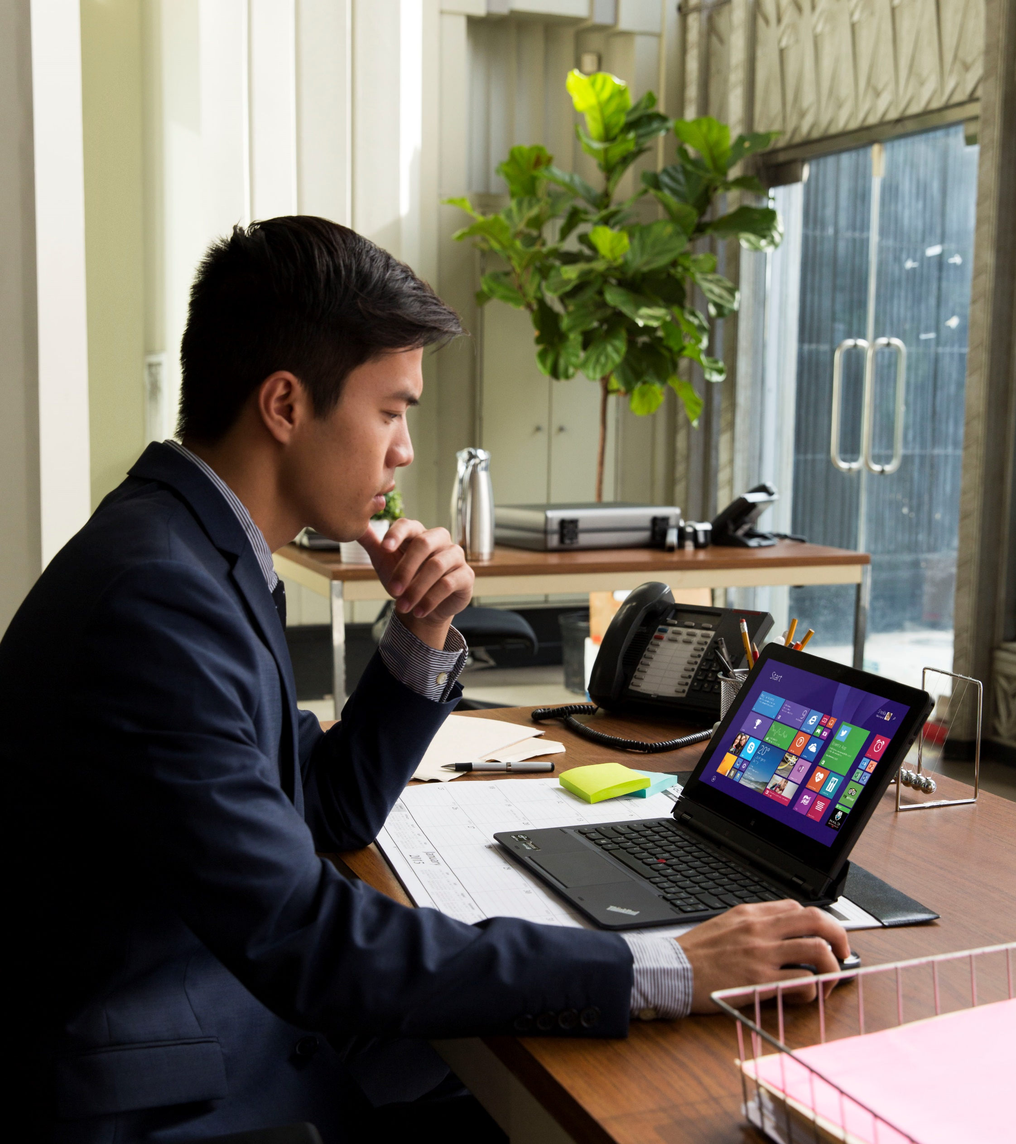
Cybersecurity in the News
PLAY
Notes:
TALK TRACK
We have all seen reports of high-profile attacks and huge financial damages to companies who have experienced them. In the past, to make it worth an attacker’s time, an organization had to be big and powerful. Most consumers and small business flew beneath the RADAR, safe in their obscurity.
This was before bots ruled the Internet; tireless bits of code that could sift through the trillions of available internet addresses, marking targets and launching exploits and penetration attempts, taking over systems and adding them to the botfleets used to launch major denial of service attacks on high-profile targets.
It wasn’t long before attackers began to realize that the systems they “owned” contained intrinsic value of their own in the form of cached passwords, banking and tax information, photos, and personal data that could be locked away and held for ransom. Ransomware was born.
Another common vector that has been wildly successful relies on the techniques of spamming and phishing to get unsuspecting users to offer their systems to those who could “help” them protect their data; instead, giving attackers complete access to their systems, networks, friends, and business associates.
CLICK PLAY

Slide 4


RANSOMWARE HAS BECOME THE BLACK PLAGUE
"We can not say it loud and often enough, ransomware has become the black plague of the internet, spread by highly sophisticated exploit kits and countless spam campaigns. ," says Cisco’s Talos. Attackers are going after bigger targets that can afford to pay more, with potentially catastrophic consequences”
A dangerous piece of PC ransomware is now impossible to crack
STEVE DENT
Engadget
March 17, 2016
Source: A dangerous piece of PC ransomware is now impossible to crack, Steve Dent, Engadget, March 17, 2016

Slide 5

RANSOMWARE SHUTS DOWN HEALTH SERVICES
“Hollywood Presbyterian declared a state of emergency over the ransomware… an unnamed doctor told the press the systems responsible for CT scans, documentation, lab work, pharmacy functions and electronic communications were out of commission… it was reported that radiation and oncology were temporarily shut down”
Hospital ransomware: A chilling wake-up call
VIOLET BLUE
Engadget
February 19, 2016
Source: Hospital ransomware: A chilling wake-up call, Violet Blue, Engadget, February 19, 2016
Notes:
Talk Track
The Hacking Team breach is a case of irony as here is an organization who’s job it is to find vulnerabilities in platforms and apps and then sell that information to the highest bidder. With all of this knowledge about hacking systems you’d think they’d be pretty good at defending themselves but the reality that all an attacker needs is access to zero day or an unpatched vulnerability and they’ll get in.

Slide 6
HACKERS HIJACK 200 MILLION DOLLAR NASA DRONE
"People might find this lack of security surprising but its [sic] pretty standard from our experience,” the group says. “Once you get past the main lines of defense, its [sic] pretty much smooth sailing propagating through a network as long as you can maintain access.”
Hackers Allegedly Hijack Drone After Massive Breach at NASA
MIKAEL THALEN
INFOWARS.COM
January 31, 2016
Source: Hackers Allegedly Hijack Drone After Massive Breach at NASA, Mikael Thalen, Infowars.com, January 31, 2016

Slide 7
IoT DEVICES UNPREPARED?
“Think of the millions of devices with video feeds—maybe the baby monitor perched over your kid’s crib or a security camera looking out over your back porch. A new feature on the most popular search engine for the Internet of Things just made it a lot easier to find such feeds. And it’s even creepier than you can imagine.”
Terrifying IoT Search Engine Lets You Spy On Strangers' Webcams
JENNINGS BROWN and ADI COHEN
Vocativ
January 25, 2016
Source: Terrifying IoT Search Engine Lets You Spy On Strangers Webcams, Jennings Brown and Adi Cohen , Vocativ, January 25, 2016
Notes:
Talk Track
The Hacking Team breach is a case of irony as here is an organization who’s job it is to find vulnerabilities in platforms and apps and then sell that information to the highest bidder. With all of this knowledge about hacking systems you’d think they’d be pretty good at defending themselves but the reality that all an attacker needs is access to zero day or an unpatched vulnerability and they’ll get in.

Slide 8
A HIGHLY COMPETITIVE UNDERGROUND ECOSYSTEM
"Uber, PayPal and even Netflix accounts have become much more valuable to criminals… Uber account information on underground marketplaces sells for an average of $3.78 per account, while personally identifiable information (PII) was listed for $1 to $3.30 on average,… down from $4 per record in 2014
Stolen Uber accounts worth more than stolen cards
HARRIET TAYLOR
CNBC
January 20, 2016
Source: Stolen Uber accounts worth more than stolen cards, Harriet Taylor , CNBC, January 20, 2016

Slide 9
"123456“, "password“, and "passw0rd” STILL IN TOP 25!
"The fifth annual SplashData chart of the internet's worst passwords is out, and it looks like people just can't learn the lesson. The firm has aggregated the passwords from around two million that were leaked in 2015, finding that basic, easy-to-guess terms are still in abundance.”
Too many people still use terrible passwords
DANIEL COOPER
Engadget
January 18, 2016
Source: Too many people still use terrible passwords, Daniel Cooper, Engadget, January 18, 2016

Slide 10
UKRAINIAN POWER GRID
Attackers were successfully able to infect computers belonging to the Ukrainian national grid, which resulted in hundreds of homes in the Ivano-Frankivsk region going dark. It's thought to be the first cyber attack to result in a power outage.
Hackers shut down power grid in Ukraine
MATT BRIAN
Engadget
January 6, 2016
Source: Hackers shut down power grid in Ukraine, Matt Brian, Engadget, January 6, 2016

Slide 11
UNITED STATES OFFICE OF PERSONNEL MANAGEMENT
“It could be the single most damaging breach to US national security of all time. Those who have access to some of the most sensitive data in the world had their entire backgrounds checks … stolen by an unknown assailant. We have yet to see the repercussions of the breach, but it could harm the US' domestic and foreign diplomatic and intelligence work.”
More than 22 million government workers now vulnerable to blackmail
ZACH WHITTAKER
ZDNet
October 2, 2015
Source: 2015's biggest data breaches: CVS, Anthem, IRS, and worse, Zack Whittaker, ZDNet, October 2, 2015
Notes:
Talk Track
Every day we hear yet another headline about an organization getting breached, frequently to spectacular effect. The info shows that the breaches are getting more frequent and the impact is moving up the hockey stick.
The US Office of Personnel Management breach will very likely be the one we talk about for years. This was no ordinary attack as the sensitivity of information stolen and the impact from a national security perspective was about as high. Think about it, the attackers literally have names and personal information of anyone and everyone who has asked for any level of clearance, including the president.

Slide 12
THE HACKING TEAM
“An unknown group of hackers brought … surveillance firm Hacking Team to its knees when its entire network was breached and published online. Hacking Team was in 2012 named as one of the "corporate enemies of the internet" by Reporters Without Borders for its role in providing tools to oppressive nations.
Hacking Team exploits put hundreds of millions of Flash users at risk
ZACH WHITTAKER
ZDNet
July 17, 2015
Source: Former staff under investigation in Hacking Team breach, Zack Whittaker, ZDNet, July 17, 2015
Notes:
Talk Track
The Hacking Team breach is a case of irony as here is an organization who’s job it is to find vulnerabilities in platforms and apps and then sell that information to the highest bidder. With all of this knowledge about hacking systems you’d think they’d be pretty good at defending themselves but the reality that all an attacker needs is access to zero day or an unpatched vulnerability and they’ll get in.

Slide 13

Sony – adding terror to playbook
“The world will be full of fear, remember the 11th of September 2001. We recommend you to keep yourself distant from the places at that time.”
Sony Hackers Threaten 9/11 Attack on Movie Theaters
BRENT LANG
Variety
December 5, 2014
Source: Hackers Threaten Sony Employees in New Email: ‘Your Family Will Be in Danger’, Dave McNary, MSN, December 5, 2014. Image: G. Hodan
Notes:
Let’s take a look at the Sony example.
This attack took things to a new level -- the privacy and safety of Sony employees, and even Sony customers, was threatened.

Slide 14
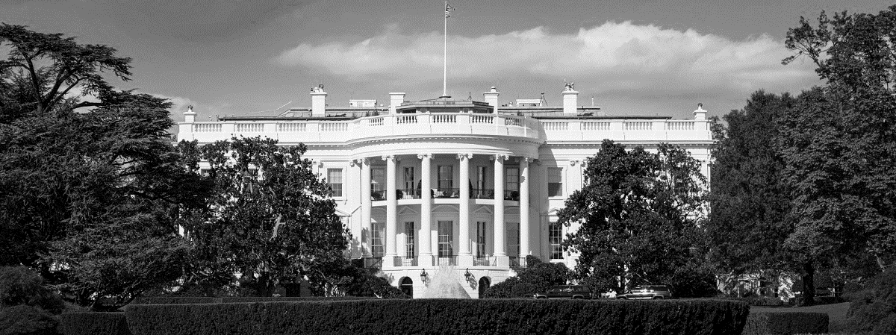
White House – unlimited budget, still vulnerable
"In the State Department breach, none of the department's classified email system was affected, a senior department official said, but the hackers used that breach to break in to the White House's network"
Hackers who breached White House network accessed sensitive data
STEVEN MUSIL
CNET
April 13, 2015
Source: Hackers who breached White House network accessed sensitive data, Steven Musil, CNET, April 13, 2015
Notes:
With the White House -- we have an example of an organization where it’s IT security is a top national priority – with vast technical resources – but a breach still occurred.

Slide 15
“… Federal cybersecurity ‘stinks’” – Washington Times
“The Obama administration’s chief human resources officer ignored warnings to shut down the very computer systems that hackers would use to steal the most personal information of millions of federal employees, Congress was told Tuesday in testimony that left lawmakers stunned at the gaps in cybersecurity.”
“And OPM Director Katherine Archuleta said they stop more than 100 million intrusions a year already, which she said proves they are making headway.”
“The OPM suffered two different hacks, one of which compromised basic personal identifying information such as dates of birth and Social Security numbers of 4.2 million current, former and prospective federal employees. The second breach saw hackers get into the government’s background check system — a potential national security nightmare, officials said.
http://www.washingtontimes.com/news/2015/jun/16/top-investigator-says-federal-cybersecurity-stinks/

Slide 16
Data Leakage
$240
87%
58%
PER RECORD
…of senior managers admit to regularly uploading work files to a personal email or cloud account¹
Have accidentally sent sensitive information to the wrong person¹
Average per record cost of a data breach across all industries²
¹Stroz Friedberg, “On The Pulse: Information Security In American Business,” 2013
²HIPPA Secure Now, “A look at the cost of healthcare data breaches,” Art Gross, March 30, 2012
Notes:
Talk Track
Data loss prevention capabilities are increasingly in demand and when you look at these first two stats it’s no wonder. 87% of senior managers leak data to unmanaged personal locations (email, cloud storage) and 58% of us have sent data to the wrong person. I actually think that stat is wrong. How could it not be 100%?
Then there is the cost of data breaches which is about 240.00USD per record. Imagine that scaled across 10 or 100’s of thousands of records.

Slide 17
“Google Play hosts over 30 malicious Minecraft apps” - Beta News
“Malware is still a worry on the Google Play store, even though the rate of malware is dropping to its lowest levels since the inception of the store in 2008.”
“Over 30 apps have been spotted using the Minecraft name, but instead of adding Minecraft content the creators would try and trick users into thinking they had malware issues. The user would be directed to sign up for "premium SMS anti-virus updates", costing £4 per week.
The 33 apps were scanned and had between 660,000 and 2,800,000 downloads. Some of the apps received over 500,000 downloads alone, showing the severity of the malware issue when it comes to app masquerading.”
“Most of these apps didn’t start out this way, originally offering low quality information to Minecraft fans in an attempt to bait them in. Once downloaded, the app would ask to be updated, and then add the anti-virus malware.
If the user is confident the app is legitimate, he/she is more likely to subscribe to the SMS anti-virus updates. It is not clear how many users actually paid for the premium service, although we wouldn’t be surprised to see less than 10,000.”
http://betanews.com/2015/05/26/google-play-hosts-over-30-malicious-minecraft-apps/

Slide 18
“'600 Million' Samsung Mobiles Vulnerable To … Attack” - Forbes
“the exploit could be used to give an attacker system user level privileges and allowing them to siphon off contact data, text messages, bank logins and most information the victim would have considered private. It could also be used to monitor users from afar.”
“in November 2014, Samsung told NowSecure it was working on a patch and eventually delivered one to carrier networks in late March for Android 4.2 and above, according to NowSecure CEO Andrew Hoog. But the company believes current devices are still vulnerable.”
“We can confirm that we have found the flaw still unpatched on the Galaxy S6 for the Verizon and Sprint networks, in off the shelf tests we did over the past couple of days,” a NowSecure spokesperson confirmed. Hoog said the flaw likely affected the majority of Samsung Android devices, including the S3, S4, S5, and Galaxy Note 3 and 4.
“NowSecure noted this does not mean users can simply download a fresh version of SwiftKey from either of the two stores. They still require a carrier upgrade for the vulnerability to be removed.”
http://www.forbes.com/sites/thomasbrewster/2015/06/16/samsung-galaxy-s6-vulnerable-to-cunning-keyboard-cracking-attack/

Slide 19
“Apple is having its Microsoft moment – CNN Money
“So much for the argument "Apple computers are safer and bug-free.“ It's not true.”
“Remember when Apple would advertise it was safer than Windows? No more. Apple is now where Microsoft was a decade ago.”
“Computer engineers, hackers and people familiar with the company's practices explained that Apple is doing five things wrong in its approach to security.
Apple's security updates are irregular and infrequent.
Secrecy
Updates are only for the latest software
Unwillingness to pay
No admission of guilt”
http://money.cnn.com/2015/06/05/technology/apple-bugs/index.html?section=money_topstories

Slide 20
“Apple CORED: Boffins reveal 0-days… – The Reg
“Six university researchers have revealed deadly zero-day flaws in Apple's iOS and OS X, claiming it is possible to crack Apple's password-storing keychain, break app sandboxes, and bypass its App Store security checks.”
“The team was able to upload malware to the Apple app store, passing the vetting process without triggering alerts. That malware, when installed on a victim's device, raided the keychain to steal passwords for services including iCloud and the Mail app, and all those stored within Google Chrome.”
"We completely cracked the keychain service … and sandbox containers on OS X, and also identified new weaknesses within the inter-app communication mechanisms on OS X and iOS ...“
“Some 88.6 per cent of 1,612 Mac and 200 iOS apps were found "completely exposed" to unauthorized cross-app resource access (XARA) attacks allowing malicious apps to steal otherwise secure data.”
http://www.theregister.co.uk/2015/06/17/apple_hosed_boffins_drop_0day_mac_ios_research_blitzkrieg/

Slide 21
“There are two kinds of big companies, those who’ve been hacked, and those who don’t know they’ve been hacked.”
-James Comey, FBI Director
200+
80
$3Trillion
$3.5Million
Median number of days attackers are present on a victims network before detection
Days after detection to full recovery
Impact of lost productivity and growth
Average cost of a data breach (15% YoY increase)
Notes:
We’re used to attackers directly targeting fortune 500s but now we’re seeing attacks on any vulnerable target.
Those numbers are scary: It takes an enterprise more than 200 days to detect a security breach and, once you finally found them, it often takes a very long time to completely recover from that breach, often up to 80 days. Attackers can wreak havoc on a corporate network, stealing data, breaching privacy, and destroying the trust of customers.
These attacks are incredibly expensive, and often come with a broader impact to a company’s reputation
And there’s also enough data today quantify what the cost of breaches is.
Note:
Source 1 (HEADING): Cyber security is a CEO issue: http://www.mckinsey.com/insights/business_technology/why_senior_leaders_are_the_front_line_against_cyberattacks
Siource 2: 243 days for attacker to be present: http://www.fireeye.com/news-events/press-releases/read/fireeye-releases-annual-mandiant-threat-report-on-advanced-targeted-attacks
Source 3: 140 countries developing cyber weapons: Infosec Institue, “The Rise of Cyber Weapons and Relative Impact on Cyberspace”
Source 4: $3 trillion in lost productivity: http://www.mckinsey.com/insights/business_technology/why_senior_leaders_are_the_front_line_against_cyberattacks
Source 5: $3.5 million cost: http://www.ponemon.org/blog/ponemon-institute-releases-2014-cost-of-data-breach-global-analysis

Slide 22
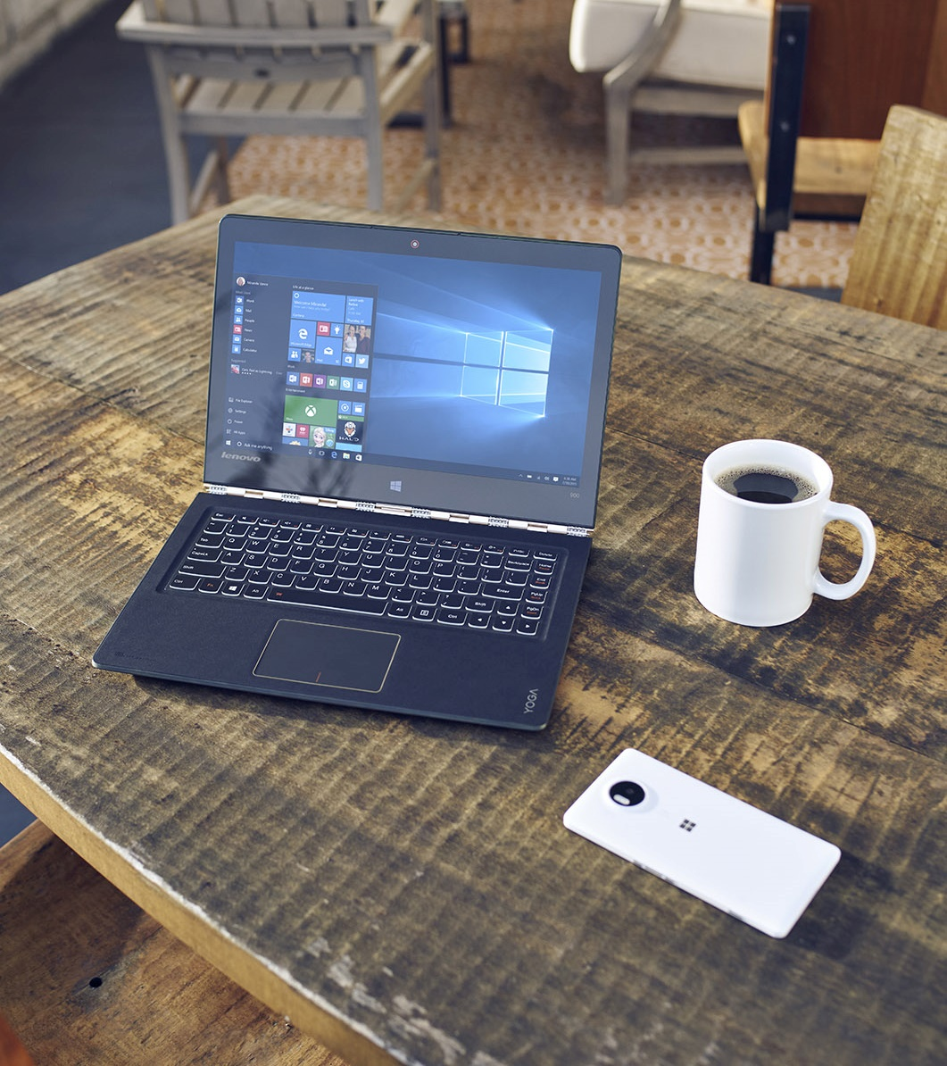
Anatomy of Common Attacks

Slide 23
How do breaches occur?
46%
of compromised systems had no malware on them
99.9%
of exploited Vulnerabilities were used more than a year after the CVE was published
Malware and vulnerabilities are not the only thing to worry about
23%
of recipients opened phishing messages (11% clicked on attachments)
50%
of those who open and click attachments do so within the first hour
Fast and effective phishing attacks give you little time to react
Notes:
Protecting our enterprise customers has never been more challenging. Security threats are increasingly brazen and highly sophisticated. Even with the best defense, sophisticated attackers are using social engineering, zero-day vulnerabilities, or even misconfigurations to break-in to their networks.
Only 40% of attacks use malware as the means of carrying out attackers’ goals. The rest consists of adversarial activity that doesn’t use malware for which signatures can be written. The better way is to detect these attacks with behavioral analysis.
It’s important to understand how those kind of breached occur, what techniques are being used and how end users help to let attackers on their machine:
As the attackers’ approaches have evolved and become more sophisticated, so too must our approach to provide security to our enterprise customers. And, our customers agree, as 90% of surveyed IT Directors said they need a full-fledged advanced threat protection solution.
Microsoft research
Note:
Ponemon Institute, “The Post Breach Boom”, 2013
Ponemon Institute, “2014 Global Report on Cost of Cyber Crime
Source: Mandiant 2014 Threat Report

Slide 24
How do these attacks usually start?
How did they get in?
How did they get privilege's?
Spear-Phishing / Social engineering
E.g. crafted emails, “Microsoft support” phone calls, USB-key in the parking lot…
‘Watering hole’
E.g. exploited websites
Direct hacking against external facing servers
Insider knowledge and privileges
0-day exploits
Vulnerabilities (CVE)
Weak defenses
Social engineering

Slide 25
Traits of an Advanced attack
Recon
Delivery
Exploitation
C&C
EoP & Lateral movement
Asset
Exfiltration
The attacker’s “kill-chain”
The attacker’s challenge
Much like in real-life attacks, planning, control and time is required for a successful attack to take place
While the compromise itself may take minutes, planning, lateral movement and exfiltration of data can take days, weeks or months
What makes is an APT?
Persistent
Targeted attacks are often and complex and lengthy operation
Stealthy
Targeted
Complex

Slide 26
THE ANATOMY OF AN ATTACK
:)
Healthy Computer
User Receives Email
User Lured to Malicious Site
Device Infected with Malware
Notes:
Talk Track
So how do these attacks start? They’re many approaches but it’s not just vulnerabilities in the server infrastructure running on the edge of your network that you need to worry about. We’ve all gotten pretty good at addressing that risk.
The risk that we need to focus our attention on is our users. They can be hacked more easily than their devices through deception. For instance they can be tricked into inputting sensitive information, such as a user name and password, into a fraudulent website that looks remarkably like their corporate website. Some studies have shown users can be tricked in high percentages, around 75% in some cases ( http://www.businessweek.com/news/2013-11-15/the-human-hack-how-to-fight-an-internet-risk-technology-cant-fix). Think about that!
So let’s talk about one approach attackers are using at scale today. In this case we start with a healthy computer.
The user received a seemly innocuous email from their organization.
It lures the user to a malicious website that
either tricks them into installing malware or it leverages a vulnerability in the browser to install it behind the scenes without the users knowledge.

Slide 27

:)
Healthy Computer
User Receives Email
HelpDesk Logs into Device
Device Infected with Malware
User Lured to Malicious Site
Identity Stolen, Attacker Has Increased Privs
Notes:
Talk Track
5. Later on the malware purposely causes the device to misbehave in order to purposely generate a call to the helpdesk.
6. The hope of the attacker is that the helpdesk will log into the device to try and resolve the issue and when they do the malware to steal the helpdesk users credentials at which point they’ll almost certainly have increased levels of privilege across the network.

Slide 28
User Receives Email
User Lured to Malicious Site
Device Infected with Malware
HelpDesk Logs into Device
Identity Stolen, Attacker Has Increased Privs
Notes:
Talk Track
Slide is animation to the next. No talking point for this one.

Slide 29









Notes:
Talk Track
From here the attacker will use the helpdesk users credentials and malware to access more end-points, steal more credentials, and within time they’ll very likely have a highly privileged IT account with administrative access to many network resources. From here your network is owned and stopping the cycle can be very difficult and at a minimum it will take time.
This is just one example and we could easily talk about many more but lets transition the conversation to how we’re going to address the threats.

Slide 30
ADDRESSING THE THREATS REQUIRES A NEW APPROACH:
RUIN THE ATTACKERS ECONOMIC MODEL
BREAK THE ATTACK PLAYBOOK
ELIMINATE THE VECTORS OF ATTACK
Security from the inside out – beyond bigger walls
Notes:
Talk Track
At Microsoft we’re taking systematic approach to disrupting the attackers.
For those with profit motive our goal is to ruin the economics of what they do. Each solution that we deliver will raise their costs substantially and we expect that this will reduce the volume of bad actors in the ecosystem.
Next we need to break their playbook and by the way we know it well. At Microsoft we have telemetry data from more devices than anyone in the world and it provides us with great insights into what the attackers are doing and how. The typical attacks that we seeing aren’t that novel and they tend to exploit the same underlying weakness in the platform that we’ve had for generations. Windows 10 we’re eliminating these types of fundamental weaknesses thus requiring the attackers to rewrite playbooks at great time and expense.
And of course the way we’ll eliminate these weaknesses is by eliminating the vectors of attack themselves by implementing architectural changes some of which leverage virtualization, containers, and other types of technologies.
With Windows 10 we don’t want the same attacks to just be harder to accomplish, meaning we just building bigger walls. We want to eliminate the attacks altogether meaning the attack “isn’t just harder to do” and instead “it just can’t be done anymore”

Slide 31
New Challenges Require a New Platform
Windows 7
Windows 10
Identity protection
Passwords theft is increasingly successful and today’s multi-factor solutions have proven cumbersome and costly to deploy.
Offers an easy to use and deploy multi-factor solution with anti-theft and phishing. Comes with the convenience of a password, but the security of the best multi-factor solutions.
Data protection
Offers optionally configurable disk encryption, but lacks integrated DLP.
Use of 3rd party solutions with varying experiences on mobile and desktop.
Market leading disk encryption increasingly enabled OOB and is highly manageable.
Data loss prevention and data separation is fully integrated into the experience.
Threat resistance
Apps are trusted until they’re determined to be a threat.
No realistic way to detect 300K’s+ new threats per day. Frequent use of 3rd party.
Mobile level of lockdown possible for desktop machines.
Devices able to move trusted app model where untrusted apps are unable to run.
Device security
Platform security built on software alone creates opportunity for malware to hide from security solutions, embedding in the device itself.
Integrated platform and hardware security provides protection from power on to power off and eliminates opportunities to tamper with and hide from the system.
Notes:
Talk Track
Windows 7 has served us well for the last 5 year but the reality is that it doesn’t offer the level of protection you need to deal with the new actors and modern threats that we’re all facing. Sure you can add additional layers of defense with 3rd party products but keep in mind that all of the organizations that we’ve reading about in the news already did that and it wasn’t enough.
These challenges require a new platform one that has been reengineered to remove some of the fundamental weaknesses that we had in the platform for as long back as we can remember. Let talk about a few of these:
Identity protection
In the Windows 7 world passwords theft is increasingly successful and today’s multi-factor solutions are too cumbersome and costly to deploy. Those who’s deployed multi-factor solutions use it sparingly across their infrastructure maybe only protecting the VPN and a few select resources with it.
In the Windows 10 world you get an easy to use and deploy multi-factor solution that is theft and phish proof. It comes with the convenience of a password, but the security of the best multi-factor solutions. Our solution works for everyone, meaning it works for consumers and enterprises, and because it’s integrated into our on-prem and cloud services it couldn’t be easier to get to.
Data protection
Windows 7 offers optionally configurable disk encryption called BitLocker, but it lacks integrated DLP. Organizations typically use of 3rd party DLP solutions on mobile devices, but do nothing for PC’s, and those solutions always compromise the user experience in the interest of security.
With Windows 10 BitLocker has been much improved and is now a leading disk encryption solution. It’s highly manageable and it will increasingly be provisioned automatically OOB on new devices. To address the needs for data loss prevention (DLP) and data separation Windows 10 now includes an in box solution. Because of its deep integration into the platform itself the protection is seamless for end users and common in capability between mobile and the desktop.
Threat resistance
In the Windows 7 world threats are addressed through detection. In other words Apps and sites are trusted until they’re determined to be a threat and with 300K’s+ new threats per day that’s a losing battle.
Windows 10 includes Device Guard which offers Mobile platform like lockdown on the desktop meaning apps have to be determined to be trustworthy before they can be run. This shift, which we’ve shipped in Windows Phone and is yielding market leading results, is now offered on the desktop. It will prove to be the most disruptive malware resistance capability we’ve ever shipped.
Device security
The world we live within in Windows 7 is one where platform security is based entirely on what software can do on its own and thus once malware compromises a key system components it can hide and possibly even embed itself into the device hardware itself.
In Windows 10 we leverage hardware based security capabilities to isolate, tamper proof, and provide integrity checks that can eliminate malwares ability to tamper with and hide from the system.

Slide 32



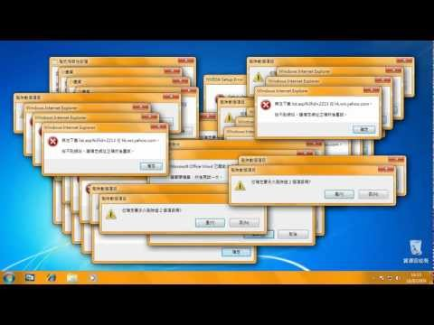

Windows Attack Surface and Vectors for Attack
Identity
Phishing/Guessing
Brute Force
Information
Sharing Mistakes
Storage Security
Common Attack Vectors
Worms/Bots
E-mail
Exploits
Secure Identities
Information
Protection
Threat Resistance

Slide 33
WINDOWS 10 PROTECTS YOU FROM MODERN SECURITY THREATS
Secure Identities
Information
Protection
Threat Resistance
Notes:
Talk Track
Windows 10 is designed to protect you from modern security treats and we’ve organized our efforts around the following pillars including secure device/hardware, secure identities, information protection and threat resistance.
Within each of these pillars you will find the largest set of security improvements we’ve ever delivered in a single release. More importantly those improvements will prove deeply impactful exactly where your organization needs it most (security).

Slide 34

The Windows 10 Defense Stack
Pre breach
Device Health attestation
Device Guard
Device Control
Security policies
Built-in 2FA
Account lockdown
Credential Guard Microsoft Passport
Windows Hello ;)
Device protection / Drive encryption
Enterprise Data Protection
Conditional access
SmartScreen
AppLocker
Device Guard
Windows Defender
Network/Firewall
Device protection
Identity protection
Information protection
Threat resistance
Notes:
Windows 10 is the most secure enterprise platform today, with enterprise security capabilities, such as:
Device Guard, Credential Guard
Secure Boot, Measured Boot
Windows Hello, Microsoft Passport
<click>
We are talking about pre breach solutions.
And by pre-breach we mean all those solutions that are built for preventing an attack to happen
But cyber attacks are getting more sophisticated
<click>
Note: If you would like to discuss in more details the security features built into Windows
Secured Devices
Device attestation
Device guard – CCI, Configurable code integrity Kernel Mode Code Integrity (KMCI)) protected by VBS (Virtualization based security)
ELAM Windows Defender trusted boot
Device control, HW turned off/on
Secured Identities
Passport, VSM
2FA
Account lockdown
Information Protection
Device protection (lost/stolen devices, BitLocker)
EDP
Data separation (BYOD, personal/corporate data) {remote wipe}
Leak protection (AAD, Azure RMS)
Sharing protection (Azure RMS, Office IRM, O365, on-prem & cloud)
Conditional access
Threat Resistance
Antimalware
Firewall
Application control (app-locker, device guard (UMCI))
Application privilege control (isolation, containment)
Web access filtering/protection

Slide 35
The Windows 10 Defense Stack
Pre breach
Post breach
Device Health attestation
Device Guard
Device Control
Security policies
Built-in 2FA
Account lockdown
Credential Guard Microsoft Passport
Windows Hello ;)
Device protection / Drive encryption
Enterprise Data Protection
Conditional access
SmartScreen
AppLocker
Device Guard
Windows Defender
Network/Firewall
Windows Defender ATP
Device protection
Identity protection
Information protection
Threat resistance
Breach detection
Investigation & Response
Notes:
This is why we are developing Windows Defender ATP.
Building on the existing security features and services Windows 10 offers today (Pre-breach), Windows Defender ATP provides a new post-breach layer of protection to the Windows 10 security stack.
Windows Defender ATP gives you the ability to detect, investigate and remediate Advanced Attacks and data breaches on your networks
It will be a new service that will leverage what we know about cyber defense and offer it as a feature to our customers
Before we dig deeper into Windows Defender ATP, lets have a look at the advantage point of Microsoft.

Slide 37
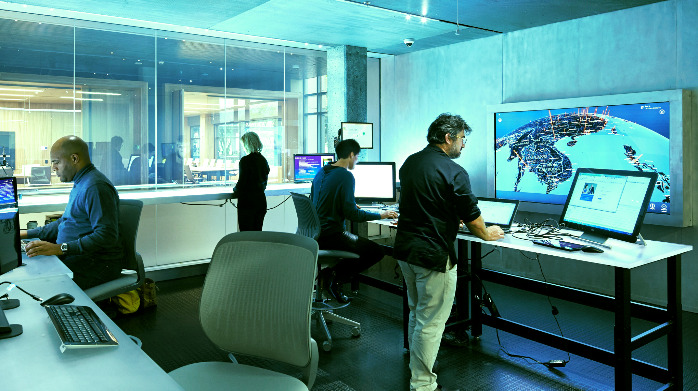
TODAYS CHALLENGE
Trusted by default, until defined as threat
Detection based methods are unable to keep up
APPS
Notes:
Talk Track
When it comes to malware, why has it always been struggle? It really comes down to problems:
Desktop platforms typically trust any app until it’s identified as a threat by something like an antimalware solution. Think about how hard it is to identify new malware instances when they’re being created by the hundreds of thousands if not millions per day. There is no way to keep up!
Users can source apps from anywhere and everywhere including malicious sites. It’s the wild west!
It turns out Microsoft has actually a solution to this problem and it’s been working great on Windows mobile, which like iOS, has a completely controlled app ecosystem. In this Windows mobile world every vendor that publishes to the store is vetted, then the apps they submit are vetted, the device can only run apps from the trusted store, and then the apps themselves are sandboxed since defense in depth is needed and we should assume the all of these checks and balances can be breached.

Slide 38
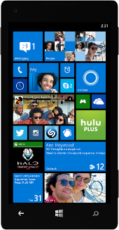
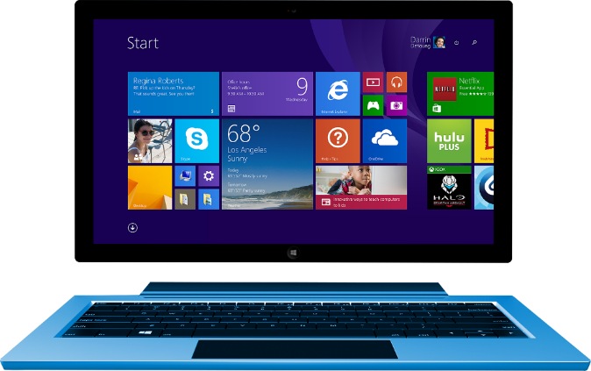
Your future must depend on:
APP TRUST MUST BE EARNED.
Notes:
Talk Track
The challenge Microsoft faces in getting you from the wild west app ecosystem that you experience on the desktop to a trustworthy app ecosystem is huge. There isn’t a switch Microsoft can just flip to instantly put the entire world of Windows apps into the circle of trust. If they could most of the malware challenges you face today would go away in an instant.
Luckily the Windows store team is aggressively working on making the Windows store, or your own Enterprise store, the center of the universe for sourcing apps whether it’s for a Universal or Win32 app but it’s going to take time. In meantime Microsoft offers next generation app control features and tools such that you can create your own trusted app ecosystem.

Slide 39
NEW APPROACHES WITH WINDOWS 10
Next Generation
App Control
Active Threat Detection
Device State based
Condition Access
Notes:
Talk Track
So getting serious about malware and hacking, is going to require adopting the next generation app control into your desktop game plan but that’s not the only solution Microsoft has up its sleeve. Major improvements in more traditional active threat detection features have also been delivered, and then in additional Microsoft is now offering capabilities that will help you prevent unhealthy device’s from getting access to business data and resource.

Slide 40
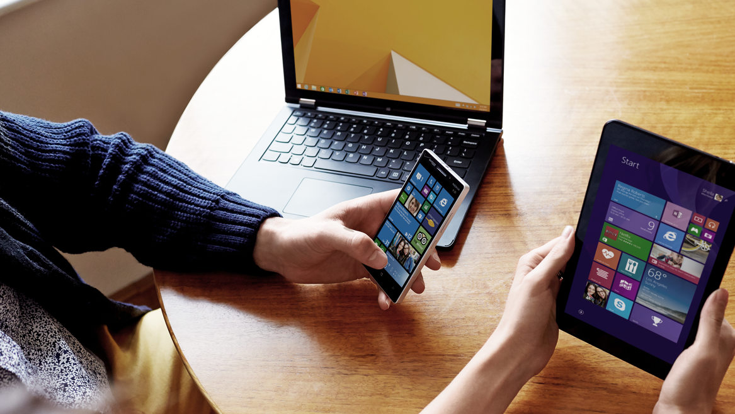

Next Generation App Control
Secure your devices with Device Guard
Notes:
Talk Track
So let’s drill down into the details of next generation app control using a new feature called Device Guard.

Slide 41
Windows desktop can be locked down to only run trusted apps, just like many mobile OS’s (e.g.: Windows Phone)
DEVICE GUARD
Untrusted apps and executables, such as malware, are unable to run
Hardware Rooted App Control
Resistant to tampering by an administrator or malware
Requires Windows 8 certified or greater hardware
Notes:
Talk Track
So what exactly is Device Guard?
It’s a device configuration for Windows that literally locks the device down, just like Microsoft does on Windows Phone, such that it can only run trusted applications. If the app isn’t trusted Windows won’t allow it to run.
The Configurable Code Integrity (CCI) policies for Device Guard are signed meaning that only a new policy that was signed with the same digital signature can replace the existing. This means that even a user or malware with administrative privilege will be unable to change the devices app control configuration.
To help protect Device Guard and the system core (kernel mode) from zero day and vulnerability exploits Device Guard uses virtualization based security and the Hyper-Visor Code Integrity (HVCI) service. This ensures everything running within the system core, like 3rd party kernel mode drivers, are designed securely and safely allocate memory. If not those components will be unable to start.

Slide 42
Supports all apps including Universal and Desktop (Win32).
Trusted apps can be created by IHV, ISV, and Organizations using a Microsoft provided signing service.
DEVICE GUARD
Getting Apps into the Circle of Trust
Apps must be specially signed using the Microsoft signing service. No additional modification is required.
Signing service will be made available to OEM’s, IHV, ISV’s, and Enterprises.
Notes:
Talk Track
Device Guard supported both Universal and Win32 apps. Trust is established when apps are signed using either the Windows store publishing process or a web service that ISV’s and Enterprises can use to sign their own applications.
The signatures that Microsoft uses to sign apps aren’t any old signatures. They’re special and either roll up to their certificate authority, one you trust, or your own. In other words the apps need to be more than signed. They need to be signed using a signature that Microsoft or you believe is trustworthy.
The apps signing process is automatic for apps that are published through the Windows store. For ISV’s and Enterprises that want to sign their own apps, Microsoft offers a secured app signing service on the Business Store Portal (https://businessstore.microsoft.com/). With this service its easy for organizations to sign any app including those from 3rd parties.
The webs service can sign actual binaries or it can sign what is called a catalog file, which is basically a hash table for the apps binaries. The catalog file can easily be generated using a tool that can snapshot a system that is in a desired state or alternatively the app setup process can be monitored. In either case a catalog file can generated as the output, merged with others, etc.

Slide 43
Device Guard in VBS Environment = Decisive Mitigation
Windows
Apps
Virtualization Based Security (VBS) Environment
Devce Guard
Trustlet #2
Trustlet #3
Windows Platform Services
Kernel
Kernel
Hypervisor
Hardware
Notes:
Talk Track
Like with Credential Guard the isolation of the Hyper-Visor Code Integrity (HVCI) process is what makes Device Guard highly resistant to sophisticated hacking attempts and inevitably it will prove difficult to bypass Device Guards app control policies. It is unique in this way vs any of the other app control solutions in the marketplace.

Slide 44
Active Threat Detection and Vulnerability Mitigations
Secure your devices from malware and hacking techniques.
Notes:
Talk Track
Device Guard can prove to be your most powerful defense but the reality is that there are environments where it might not be a perfect fit. For this reason Microsoft offers a deep bench of active threat detection and vulnerability mitigations to complement Device Guard and protect those who choose not to deploy it.
We think the best way to approach threat resistance is to use a mental model that is built around:
Device integrity that can prevent hardware tampering and malware from starting before Windows
Next we need to think about platform integrity which is where we ensure that Windows components and even the anti-virus software are protected from tampering
Once you have a platform up and running and start running apps you need to have platform and apps security to sure both are resistant to exploits when vulnerabilities are discovered, apps can be managed, etc.
Next you as your users connect their devices you need online safety capability to help ensure the system and users can’t be deceived by phishing campaigns, inadvertently download malware, etc
And then we need to assume all of those systems will fail and we need to prevent unhealthy devices from connecting to resources as once they do, they’ll proliferate the infection within your network.

Slide 45
Device level malware can hide from defenses and can gain full system control
DEVICE INTEGRITY
Attacks tamper with system and device firmware, disk structures, and start malware before Windows
Ensuring Windows can start on a trustworthy device
UEFI provides tamper proofing for firmware and protects the firmware of all Option ROMs
UEFI ensures Windows starts before any other software (e.g.: bootkit)
TPM provides services to enable local and remote verification of the system’s integrity (trust but verify)
Notes:
Talk Track
So let’s drill in a little deeper into the Device Integrity which is something that we focused on extensively in Windows 8.
The challenge that we face is that device level malware can hide from defenses and gain full system control. It does it by tampering with system and device firmware, disk structures, and in the end malware is able to starts before Windows.
Starting before Windows, and thus before your system defenses, including 3rd party, is quite literally a worst case scenario as once done the ability for the malware to hide from the system and its defenses is all but assured. Your management systems will think everything is green when in actuality those systems are actively being lied to by something they very likely can’t see.
The solution to this problem comes by way of modern Windows 8 generation hardware which includes a new technology called UEFI. UEFI (v2.3.1) starting with Windows 8 certified devices prevents tampering with the UEFI/BIOS firmware and UEFI won’t initialize devices if they allow unsigned or have tampered with firmware within their Option ROMs.
In addition UEFI with its Secure Boot feature prevents any 3rd party software from starting before Windows so bootkits simply can’t start on the device.
UEFI is a decisive solution but we have to assume breach and that defects in the UEFI implementation my lead to bypasses. To address this modern devices which include TPM provides us with the ability to locally and even a remotely confirm that device and UEFI firmware are tamper free and that Windows in fact was the first operating system that started on the device. You’ll find this mentally of trust but by verify in many places within Windows 10.

Slide 46
Attacks tamper with system, core and 1st and 3rd party system defenses
PLATFORM INTEGRITY
Windows Trusted Boot prevents malware from starting during the boot process and protects anti-malware solutions
Protects the integrity of Windows, 3rd party defenses and apps
Windows isolates system core and puts sensitive processes into containers – offering protection even with a kernel level breach
Provable PC Health remotely verifies health, can initialize remediation, and provides services for conditional access scenarios
Notes:
Talk Track
So once we have a pretty strong assurance that device integrity can be maintained and that a tamper free version of Windows will start but how do we protect the rest of the platform? That’s where our investments in platform integrity come into play.
Once Windows start on the device one of the very first actions it talks to start the Windows Trusted Boot feature. This feature picks up where UEFI Secure Boot finishes and provides the same type of protection as Windows start up its system core (kernel), privileged drivers, and system defenses such as the antimalware solution. The idea here that if we can prevent malware from being able to start early in the boot process and system defenses we can prevent it from hiding from them. Like UEFI Secure Boot this is an architectural change that effectively eliminates the potential for rootkit attacks, meaning those that gain system access by tampering with the Windows boot process.
In another example of our “trust but verify” mentality Windows runs a process called Measured Boot which like UEFI can use the system TPM to locally or remotely confirm that Windows boot process started tamper free.
Unlike Windows 7 and 8 where all processes are started and thus under the control of the Windows system core (kernel) some critical system process have been moved into a secure execution environment that run isolated from the core operating system. On devices with Virtualizations Extensions (e.g.: Intel iCore processors and others (AMD) like it) we can boot a Hyper-V hypervisor and start an instance of Windows as well as an instance of the secure execution environment in parallel. We call this technology a Virtual Based Security Mode (VBS).
VBS will host select Windows processes in what is effectively a secure container. Processes in this container are effectively immune to tampering my Windows even if the system has been fully breached and the attacker has full Admin or System level access. We’ll talk more about what processes run within the VSM later on in the system but since I’m into spoilers I’ll tell you now. Windows 10 will run the Hyper Visor Code Integrity (for Device Guard) and the Authentication Broker (LSA Service) (Credential Guard).
The last thing worth talking about is yet another “trust but verify” feature. So far we’ve just talked about features enable verification but we haven’t talked about features that actually do verification. With Windows Device Health Attestation (WDHA) the integrity and health of a device can be remotely validated. When WDHA is used with a management system such as a MDM solution like Intune, or even a 3rd party system, access to resources can be based on a device’s health state. This is called conditional access.

Slide 47
PLATFORM AND APP SECURITY
Attack exploits vulnerabilities to gain foothold and compromises users identity, data, or uses device for own purposes
Protects system and apps from the most common attacks and malware
Windows vulnerability mitigations (e.g.: ASLR, DEP, CFG, etc) reduce or eliminate the ability to exploit a vulnerability
Notes:
Talk Track
When we talk about Platform and Apps security we’re focusing on ensuring the platform and apps can’t be manipulated or controlled with while they are running. This is different than how we think about Device and Platform integrity where we’re for the most part talking about attacks that literally change, possibly replace, device firmware or the OS components themselves.
The typical attack vector here where the attack exploits vulnerabilities in the platform or apps thus enabling them gain control of its functions. From here attacks go after users identity, data, or they’ll use the device for their own purposes (e.g.: BotNet for sending spam, DDoS).
The reality when it comes to vulnerabilities is that as long as human being are writing software they’ll continue to introduce vulnerabilities into their code. Some organizations will better than others and I’m happy to say that Microsoft is a leader in code quality we have the fewest vulnerabilities per line of code than about anyone in the world. We’re proud of our accomplishments here and we share our process, which we call Security Development Lifecycle, with the world such that they can take advantage of our expertise in the area.
With Windows 10 we have a deep bench of functionality it that is designed to deal with the eventuality that vulnerabilities will be discovered in the platform or the apps running on top of it. We call these vulnerability mitigations and they’re designed to prevent attackers from being able to manipulate app functional are already running system in memory.
The typical vulnerability exploit enables the attacker to replace function of an application running in system memory with their own. From here this malicious function will very likely initiate the installation of additional malware which will give the attacker much broader control and access to the system.

Slide 48
WINDOWS VULNERABILITY MITIGATIONS: RAISING THE BAR AND COSTS FOR THE BAD GUYS
Prior to 2003
Windows XP SP2
Windows Vista and 7
Windows 8
Windows 10
Enhancements
No mitigations
DEP
/GS
SafeSEH
Heap hardening v1
ASLR v1
SEHOP
Heap hardening v2
ASLR v2
Kernel SMEP & DEP
Heap hardening v3
CFG
Impact
Exploitation was not inhibited
Data can’t be executed as code
Protection for stack buffers, exception chains, and heap metadata
Memory layout is randomized
Improved protection for exception chains and heap metadata
Improved memory layout randomization
Improved protection for heap metadata & buffers
Only valid functions can be called indirectly
Notes:
Talk Track
Prior to Windows 2003 and up until XP SP1 we didn’t really have any mitigations in place to deal with vulnerabilities in the platform and apps running on top of it. Attackers weren’t really focused on them but that all changed in 2003 when attacks like Slammer and Blaster wreaked havoc on organizations.
It was a big wake up call for the industry and Microsoft in particular and we responded as quickly as possible by creating the Trustworthy Computing organization, the Security Development Lifecycle (SDL) for secure software development, and of course we delivering XP SP2 which includes a number of mitigations to help prevent vulnerability exploits.
An attackers ability to successfully exploit a vulnerability depends on their ability to place exploit code into a very precise location in memory such that it can be executed later on. In XP SP2 we introduced Data Execution Prevention (DEP) which enables a developer to define which memory addresses for their app require the ability execute code vs which ones are just here to store read only data. DEP basically reduces the surface area of where an attacker can insert malicious executable code into an app.
One of the most impactful mitigations was the introduction of Address Space Layout Randomization (ASLR) in Windows Vista which is another capability designed to make it more difficult for an attacker who finds a vulnerability from being able to exploit it. ASLR randomizes system memory making it very hard for them to find useful memory locations to insert malicious executable code.
DEP and ASLR were effective when implemented but the reality is that Windows itself wasn’t able take advantage of it due to legacy dependencies and app compatibility issues. In the end just a subset of Windows was being protected by these technologies and of course the attackers found out where and they even discovered some bypasses.
To deal with this in Windows 8 we took the time to app compatibility issues and we’re now in place where both DEP and ASLR are used holistically across the system. We also rev’d ASLR to version 2.0. In 2.0 we increased the level of entropy by magnitudes of order making “the random” that much more random and we even started to take advantage of a 64bit range of memory addresses which increases the total surface area of memory we can randomize across. Our analysis of all of the vulnerability exploit techniques in use by the attackers on 7 showed us that these changes to ASLR and DEP would break over 95% of their techniques.
In Windows 10 we’ve added another mitigation that is designed to break the attackers cookbook. This feature is called Control Flow Guard (CFG) which is designed to deal with ASLR bypass techniques. As mentioned earlier ASLR randomizes memory making it hard to find useful places to insert code but what if an attacker could find a way to get an app to disclose where it stores things in memory. In this case you’d be able to bypass ASLR. Using a technique called “Use after Free” an attacker can do just that so we’ve added a new feature to help prevent these types of disclosures. I’ll show you the impact of this feature later on when we talk about IE improvements.

Slide 49
PLATFORM AND APP SECURITY
Attack exploits vulnerabilities to gain foothold and compromises users identity, data, or uses device for own purposes
Windows vulnerability mitigations (e.g.: ASLR, DEP, CFG, etc) reduce or eliminate a vulnerability’s ability to be exploited
Protects system and apps from the most common forms of malware
Windows sandboxes Universal Apps (AppContainer), validates app integrity (Code Integrity), and offers app control (AppLocker)
Windows offers a new Secure Event Channel for advanced malware analytics and unparalleled app compatibility for 3rd party security solutions
Notes:
Talk Track
Significant investments in vulnerability mitigations are a critical for the platform, and in particular Win32 apps, that have the potential to enable attackers to gain the highest level of privilege.
With Universal Apps we have another and very decisive mitigation at our disposal which is the ability to sandbox Universal Apps using AppContiner technology. We originally shipped in this Windows Phone 7 and then later on we integrated the capability into Windows 8. Our sandboxing technology inherently runs the application with least privilege and the sandbox prevents it from tampering with the system, data, and others apps. Universal Apps must declare what system services they need access to and they get no more and no less. Consumer and the community can see what capabilities are being used by apps in the store and they can ask questions when an apps appears to require more capabilities than they should. And finally Windows flags certain capabilities, those that grant access the app access to sensitive data feeds such as those that can come from the camera, GPS, microphone and when you install they app. Windows will ask you if you’re sure that you want to grant the app access to these sensitive resources in an intuitive and simple way.

Slide 50
ONLINE SAFETY
Windows includes Windows Defender, an advanced malware solution
Protecting the system and apps from the most common forms of malware
Notes:
Talk Track
If our devices weren’t connected to networks, and especially the internet ,we’d have very little to worry about. Thankfully that’s not the world we live but the price we have to pay is that we need to make big investments in making that online experience safe.
Configuring your devices with Device Guard is clearly your best and most decisive defense but if that isn’t going to work for all of the devices in your environment you’ll find and antimalware solution like Windows Defender is going to be one of the most important defenses.
I’m happy to announce that Windows Defender has been dramatically improved in Windows 10.

Slide 51
Windows Defender
Protected by Default
Detection Improvement
Resilience and Recovery
Windows Defender in Client & Server
User Always Protected
Malicious Software Removal Tool
Protection Cloud
Antimalware Scan Interface
Secure Kernel Event Channel for Antimalware
Windows Defender Offline in WinRE
Protecting the Guard (get)
Notes:
Talk Track
One of the challenges we faced with any vendors antimalware solution is that when malware gets onto the devices with sufficient privilege is pretty effective as disabling the AV solution. In the consumer space we see large percentages of devices that are either out of date, have been disabled by malware, and in many cases they’re simply devices that were protected by a trial or subscription based antimalware solution that has since expired.
Starting with Windows 10 when a 3rd party antimalware solution has expired and is offering no protect we will help the user re-subscribe to their original antimalware solution. We’ll remind them a number of time but if within 3 days they don’t act we will automatically turn on Windows Defender such that they can be protected. The numbers we have suggest this will have a huge impact.
In addition we’ve added Windows Defender to Windows Server which has been big ask from our customers.
We’ve also dramatically improved Windows Defenders ability to detect malware. Windows Defenders takes full advantage of the power of the cloud to get the fastest possible detection times, even for highly polymorphic malware. For instance in some cases a device won’t have a signature for new malware that we are aware of but your AV solution hasn’t yet received this latest signature file from Windows Update. When new suspicious files are detected on the system we can quickly use the cloud to vet whether or not we know the reputation and if need be we can automatically force a cloud block well ahead of the distribution of the signature file. In addition the Windows Defender is taking full advantage of the new APIs and event channels that we designed based on 3rd party feedback giving the best protection capabilities yet.
The last thing we have time to discuss is related to making Windows Defender less susceptible to malware tampering. We call this protecting the guard. In Windows 10 Defender has been isolated in the system, using a technology we call Protected Processes, such that malware can’t tamper with its configuration and state. Interaction with Windows Defender and its configuration can only occur with process that are trusted and signed using a special process. This level of protection is also available for 3rd party solutions.
We have to assume that all of the defenses will fail us and to deal with this eventuality we’ve put Windows Defender Offline in the Windows Recover environment. In the event that Windows Defender can’t resolve an issue because the malware is too deep in the system Windows can boot into the secure Windows Recover environment and repair the system form there. No longer do you need to go to the web to acquire an offline scanning tool that runs from a USB, DVD, etc.

Slide 52
ONLINE SAFETY
Windows includes Windows Defender, an advanced antivirus and malware solution
Protecting the system and apps from the most common forms of malware
Windows and IE SmartScreen block malicious websites and apps before they get a chance to impact the device
Notes:
Talk Track
Windows Defender will be better than ever but that just one part of the stack. Another important solution for online safety is Internet Explorer.

Slide 53
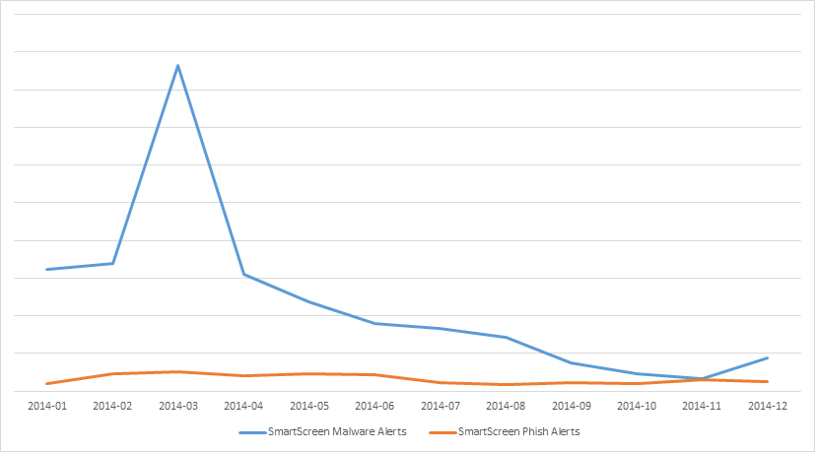
IMPROVEMENTS IN IE MAKING IT THE MOST SECURE VERSION YET
SmartScreen App and URL Reputation
IE with SmartScreen technology provides enhanced protection
Blocking of Phishing and Fake downloads increased
Notes:
Talk Track
It turns out that the best pathway for threats, whether they are phishing or malware related, is through a browser. It could be IE, Firefox, Chrome, you name it.
As opposed to the antimalware solution which addresses threats after they’ve already landed on the device the browser is in the unique position to be able to detect and block the threats before ever make it. This type of blocking is done using SmartScreen technology and it quite literally is your front line defense while your online.
SmartScreen technology takes advantage of the near unlimited computer of the Microsoft cloud which crawls the internet looking for new URL’s and Apps to apply reputations to. From here Windows and Internet can block malicious, or even suspicious, sites and apps. Our ability to identify malicious sites will be improved.
When it comes to APP reputation in Windows 8.1 we actually moved the functionality, which was in IE, into the Windows platform itself. This helps us ensure that content whether it comes through the browser, USB, etc can be vetted and blocked no matter what pathway it comes by way of. This functionality has literally block billions of malicious apps from devices.

Slide 54
ONLINE SAFETY
Windows includes Windows Defender, an advanced malware solution
Protecting the system and apps from the most common forms of malware
Windows and IE SmartScreen blocks malicious websites and apps before they get a chance to impact the device
Internet Explorer provides zero day protection for commonly used exploit techniques and can prevent the use of unsafe or unpatched browser extension (e.g.: Flash, Java, ActiveX)
Notes:
Talk Track
Next let’s talk about zero day’s which is something that customers are constantly asking about. The challenge with a zero day is you don’t know about it until the day it’s used by someone and of course by then it’s too late.
Since it’s impossible to imagine vulnerabilities not being discovered in software we’re investing in defenses that can eliminate to at least mitigate the impact they can have. Some of these mitigations we’ve already talked about earlier when we talked about Platform and App security but I thought I’d show you the impact that these mitigations have had for IE and its users.

Slide 55
IMPROVEMENTS MAKING IE THE MOST SECURE VERSION TO DATE
Improved Exploit Protection
Advanced protection against memory corruption attacks
Common bug classes are strongly mitigated by new memory protection features
Control Flow Integrity is on by Default blocking most exploit techniques
Notes:
Talk Track
As you can see in the chart on the right memory protection features like ASLR, DEP and others have had a big impact since we started to introduce them.
The chart is showing the number of IE version in the market place that were impacted by various exploit techniques along the time continuum. You’ll see prior to 2009 pretty much all of our in market browser were susceptible to the zero days detected at the time. In 2009 we shipped Windows 7 and we actually back ported some of the memory protected features to down-level version of IE and this is where you start to see things go green. We had a few issues pop up in 2010 and 2011 but we tackled those since about mid 2011 those features have been protecting us against the zero days discovered in IE.
On 5/1/2014 we ran into a new vulnerability that impacted versions of the browser and Windows all the way back to XP and if you remember this was discovered right after the XP EOS date had passed. We had promised never again to patch XP after the EOS date had passed but because of the nature of the issue we decided deliver one more patch. It was the right thing for Microsoft to do for its customers but that’s really just a tangent.
The point we’re trying to make is that our efforts to deal with zero day attacks on IE is working well.

Slide 56
IMPROVEMENTS MAKING IE THE MOST SECURE VERSION TO DATE
Improve Extension Management
Java blocking introduced
The most commonly attacked out-of-date plugins are blocked by default removing the most common exploit vector
Notes:
Talk Track
This next IE protection mechanism that were going to discuss has already been released to existing customers it’s had an amazing impact on the behavior of the attackers.
As you’ve seen in the previous slides there are very few zero day attacks against IE and the mitigations we have in place make them very difficult to pull off and it is for this reason that attackers have redirected their attention to the plug-ins, such as Java and Flash that run within it.
In this stack chart you can see Java was the primary target of the attackers until September 2014 which his when we shipped an IE update that prevented unpatched version of Java from running the browser. Once we did this you’ll see that the attackers quickly moved away from Java and are now focusing all of their attention on Flash. Flash has the same problem when it comes to patching and starting in March of 2015 we’ll blocking unpatched version of Flash in IE.
This change will obviously be quite devastating to the bad guys and I think we can safely speculate what the chart will look like shortly after. We can also say that were will dramatically less vulnerable targets to attack through Java and Flash exploits.

Slide 57
Secure Your Environment with Conditional Access
Keep unhealthy devices out with Intune and Windows Device Health Attestation
Notes:
Talk Track
So there are a lot of great technologies in Windows 10 to help keep your devices secure but like we’ve said before you need to have an assume breach mentality. Now more than ever you need to start identifying and blocking unhealthy devices from your networks using hardware based conditional access capabilities.

Slide 58
Unknown PC Health
TODAY
HEALTH IS ASSUMED
Important resources
File Servers
OneDrive
1
Access please
Email
Wireless
2
You’re in
Notes:
Talk Track
One of the challenges with access control is that in most cases it’s just focused on making sure that the right people get access to the right resources. If a users authenticates, they’re going to be given access and with BYOD it that access will occur using a device that IT knows very little about.
Yes, IT may be able to configure the device to be in a certain state but is it really secure? For instance maybe IT can make sure that your device is encrypted before giving you access to email, but what if your PC infected with malware? Does anyone really deploy solutions that do this kind of analysis? Few do and most management systems will just let you in regardless of the state. Even if they’re using something like Cisco NAC or Microsoft’s NAP, these solutions don’t have the ability to deal with sophisticated malware such as boot and root kits that frequently can hide from everything short of an offline scan.

Slide 59
Windows Device Health Attestation (WDHA) service provides validation of device integrity data
CONDITIONAL ACCESS
Management systems (e.g.: Intune) can leverage WDHA attested integrity data to facilitate conditional access to resources
Blocking unhealthy devices to protect resources and prevent proliferation
Management may couple WDHA attested integrity data with additional health state data (e.g.: patch status) to provide more comprehensive view of device health
The integrity data from the WDHA service is available for use by 3rd party network access, security, and management solutions.
Notes:
Talk Track
To address this Microsoft is delivering the Windows Device Health Attestation (WDHA) which can be used to remotely determine the integrity and health of a device. When WDHA is used with a management system such as a MDM solution like Intune, or even a 3rd party system, access to resources can be based on a device’s health state. This is called conditional access.
Lets drill into this scenario a bit more.
In Windows 10 Microsoft has updated the WDHA service (formerly referred to as Provable PC Health) cloud service that they launched with Windows 8.1 with enhanced capability. Unlike the version for 8.1 that was designed for consumers and just enabled Windows to inform users through action center or email that their PC’s were infected with malware that required special offline scanning and remediation techniques, they’ve updated it to provide this same capability to enterprises along with the ability to use this information to make Conditional Access decisions.

Slide 60
Windows Device Health Attestation Enables:
MDMs TO GATE ACCESS BASED ON DEVICE INTEGRITY AND HEALTH
Device Integrity Health State s (Windows Cloud Service)
Client Policies(AV, Firewall, Patch state (e.g.: Intune)
Windows Cloud Service and Intune
Request
3
4
Approved
Important resources
File Servers
OneDrive
5
Here is my proof
2
Email
Wireless
Prove to me you are healthy
1
Access please
Notes:
Talk Track
So what exactly does the Windows Device Health Attestation (WDHA) cloud service do and how does it contribute to a conditional access scenario?
WHDA is a service that is able to securely collect and validate but not analyze device integrity data (e.g: UEFI Secure Boot state, Windows boot component integrity (i.e.: Measured Boot), etc), and then from here the service is able to confirm that the data was hardware generated by a trustworthy TPM and that the data is tamper free. From here the service signs the package that contains the data and passes it back to the client such that later it can be analyzed by a management solution upon request. This management solution may use this data for reporting purposes or to enable conditional access scenarios.
In the case of a conditional access scenario a client managed by a solution like Intune will have it’s access to resources gated based on it’s ability to prove that it’s healthy. To do this the client will pass the package that was signed by the WHDA service to the management solution for analysis. Next the solution will validate that the data was signed by the WHDA service and its tamper free, and then from here it will extract the data and analyze it. The management solution will validate the devices health state based on the device’s boot state and other attributes from the package and if the initial validation checks pass it can optionally request additional information about the its patch state, AV signature level, device encryption state, etc. Based on the results of the complete analysis it will enable the device to access resources or deny it.
This feature is awesome and is much needed for BYOD devices that today are connecting to your network and very likely becoming the gateways to malware proliferation and greater network breaches.

Slide 61
Secure Identities
Information
Protection
WINDOWS 10 PROTECTS YOU FROM MODERN SECURITY THREATS
Threat Resistance
Notes:
Talk Track
So there you have it. Windows 10 offers breakthrough technology that quite literally walls of the most common attacks that are being launched against your organizations. It helps you move to costs effective two factor authentication and protects user credentials from misuse, it provides data separation and data loss prevention capabilities, and finally it offers the most decisive solution in the fight against malware and online threats.
Windows 10 user and devices are going to become the hard target for the bad guys and from our view it’s a critical upgrade. Five year ago (2009) Windows 7 wasn’t designed to protect you from the threats that have emerged in recent years. It’s now your choices to be the remain the soft target or become the hard one.

